Slide 1
Patient positioning and potential injury
R1 ชนาธิป มีรอด / อ. ณรงค์ศักดิ์ เจษฎาภัทรกุล

Slide 2
Outline
Physiologic alterations from positioning
Purpose of patient positioning in OR is to facilitate the surgical procedure
Review the most common surgical positions
Specific risks and injuries associates with different surgical position

Slide 3
Physiologic considerations of positioning
Upright to supine
Venous return preload
SV CO
BP
Activates afferent baroreceptor & mechanoreceptors
Sympathetic outflow
HR CO
Miller’s anesthesia : patient positioning and associated risk,9th ed;2020

Slide 4
Physiologic considerations of positioning
Upright to supine
Venous return preload
SV CO
BP
Activates afferent baroreceptor & mechanoreceptors
Sympathetic outflow
HR CO
Inhale anesthesia
Intravenous anesthetic
vasodilation
General anesthesia
Miller’s anesthesia : patient positioning and associated risk,9th ed;2020

Slide 5
Physiologic consideration
Upright to supine
Cephalad displacement of the diaphragm
FRC TLC
Miller’s anesthesia : patient positioning and associated risk,9th ed;2020

Slide 6
Physiologic consideration
General anesthesia
TV FRC closing volume
MV atelectasis
V/Q mismatch
Positive pressure ventilation
Muscle relaxant
PEEP
Miller’s anesthesia : patient positioning and associated risk,9th ed;2020

Slide 7
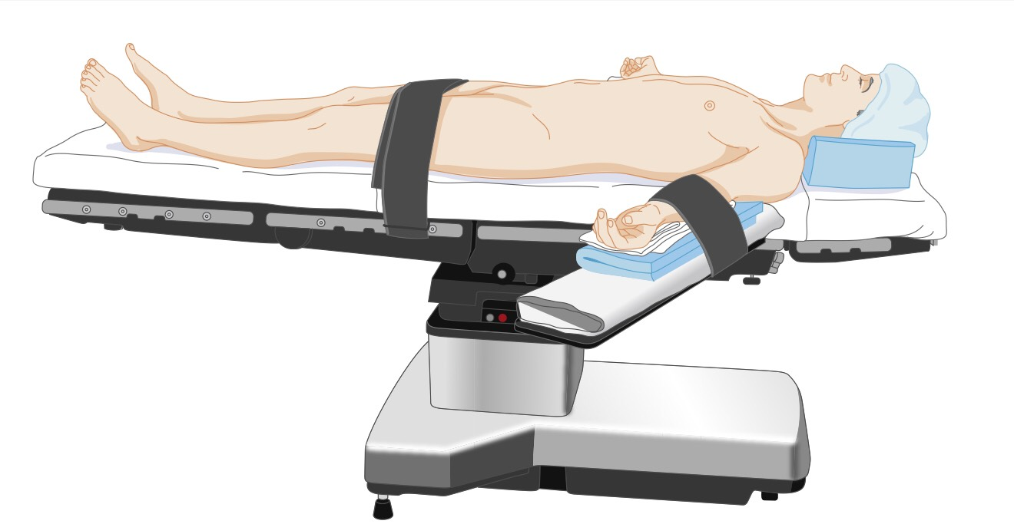
Supine position
Most common position for surgery
Head, neck, spine all retain neutrality
Arm should be placed in neutral position
Abduction limited < 90 degrees (prevent branchial plexus injury)
Hand and forearm can be supinated in neutral position
Padding bony prominent ; elbow, IV, monitoring equipment
Miller’s anesthesia : patient positioning and associated risk,9th ed;2020

Slide 8
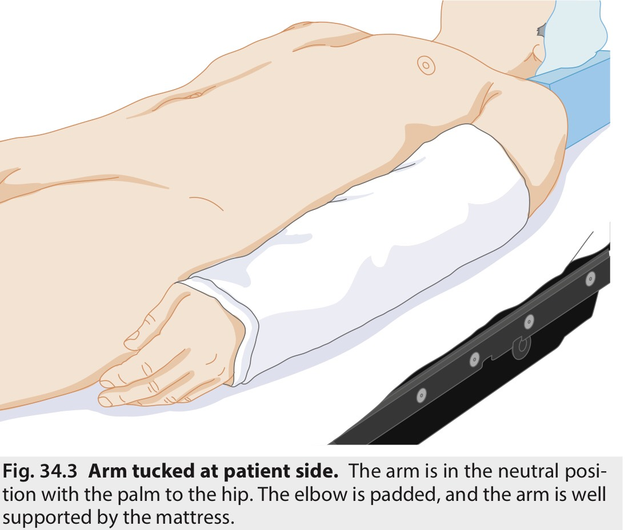
Miller’s anesthesia : patient positioning and associated risk,9th ed;2020

Slide 9
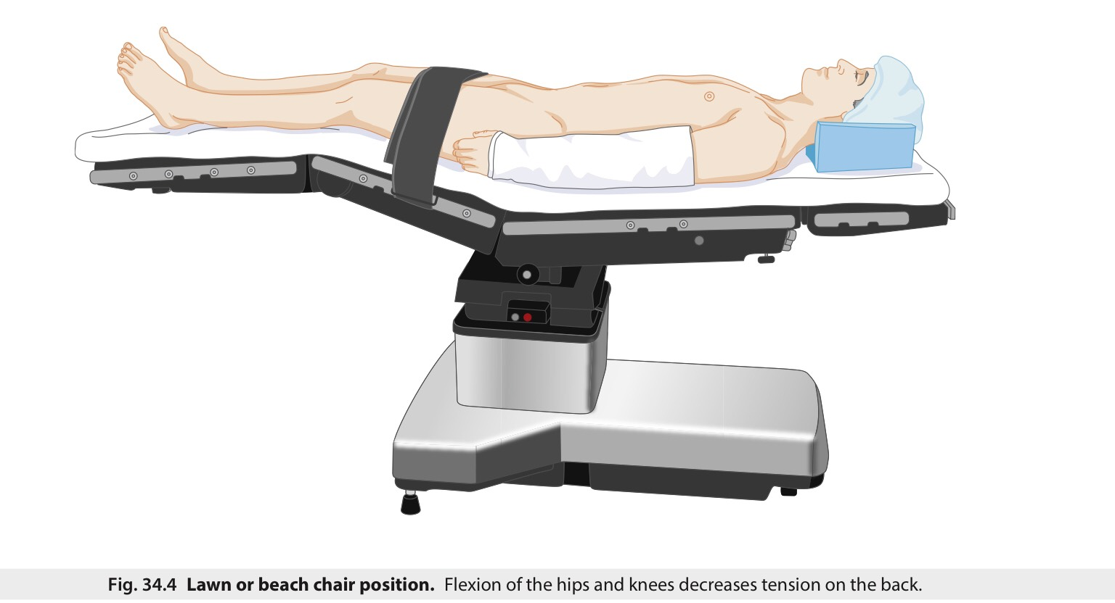
Variation of supine position
Reducing stress on back, hip, knee
Facilitate lower extremity venous drainage
Abdominal wall tension reduced
Better tolerated by awake patient or under monitored anesthesia care
Miller’s anesthesia : patient positioning and associated risk,9th ed;2020

Slide 10
Trendelenburg position
Miller’s anesthesia : patient positioning and associated risk,9th ed;2020

Slide 11
Trendelenburg position
Improve exposure during abdominal and laparoscopic surgery
Venous return CO
FRC Airway pressure work of breathing
IOP ICP contraindication in patient with increased ICP
Increased risk UAO [ Swelling of face, conjunctiva , larynx, tongue ]
Intraabdominal pressure >> aspiration
Reverse Trendelenburg reduces CPP and may also cause hypotension
Miller’s anesthesia : patient positioning and associated risk,9th ed;2020

Slide 12
Complications of supine position
Back pain ( loss of lumbar lordotic curve & decreased paraspinous muscle tone )
Kyphosis, scoliosis, history of back pain
( require extra padding of spine or slight flexion at hip and knee )
Peripheral nerve injury ; ulnar neuropathy, branchial plexus injury
- Maintaining head in midline
- limit arm abduction < 90 degrees at shoulder
- Hand and arm supinated in neutral position
Miller’s anesthesia : patient positioning and associated risk,9th ed;2020

Slide 13
Miller’s anesthesia : patient positioning and associated risk,9th ed;2020

Slide 14
Lithotomy
Gynecologic, rectal and urologic surgery
Hip are flexed 80-100 degrees, legs are abducted 30-45 degrees from midline
Venous return CO
Intraabdominal pressure lung compliance TV
Lower extremity compartment syndrome
[ tissue pressure within fascial compartment due to ischemia
edema, rhabdomyolysis]
Miller’s anesthesia : patient positioning and associated risk,9th ed;2020

Slide 15
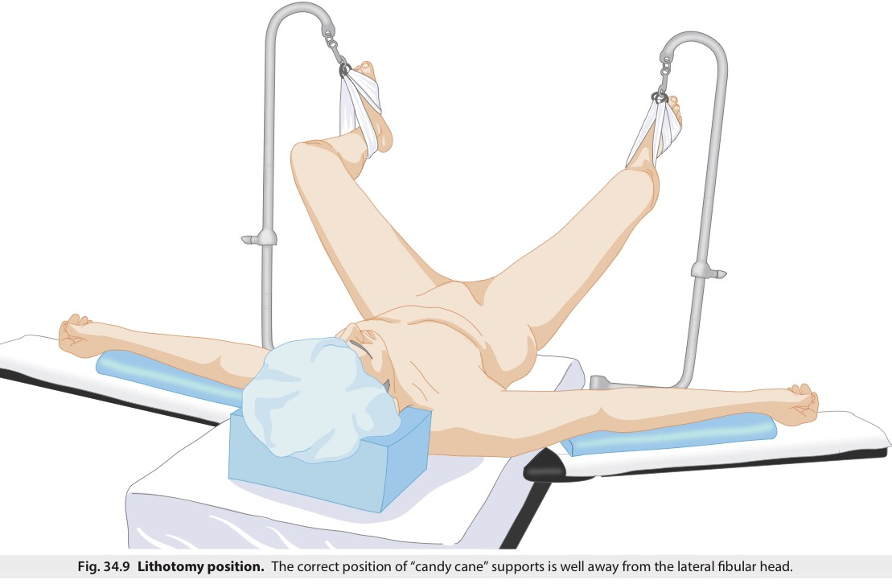
Lithotomy
Miller’s anesthesia : patient positioning and associated risk,9th ed;2020

Slide 16
Miller’s anesthesia : patient positioning and associated risk,9th ed;2020

Slide 17
Lateral decubitus
Use for thorax , retroperitoneal structure, hip surgery
Dependent leg is flexed to minimize stretch of lower extremity nerve
Point of flexion and the kidney rest should lie under iliac crest
Head and neck must be kept in neutral position
Axillary roll is to protect dependent shoulder and axillary content from weight of the thorax
Miller’s anesthesia : patient positioning and associated risk,9th ed;2020

Slide 18
Lateral decubitus
Dependent eye & ear may be at risk injury
Early of compression of axillary neurovascular structure
(low pulse oximeter, hypotension)
V/Q mismatch
dependent lung- underventilation + increased pulmonary blood flow
non dependent lung - overventilation
Prefer in pulmonary surgery and one lung ventilation
(non dependent lung is collapsed, MV is allocated to the dependent lung)
Miller’s anesthesia : patient positioning and associated risk,9th ed;2020

Slide 19
Miller’s anesthesia : patient positioning and associated risk,9th ed;2020

Slide 20
Miller’s anesthesia : patient positioning and associated risk,9th ed;2020

Slide 21
Prone position
Posterior fossa of skull, posterior spine , posterior lower extremities
Head is kept neutral using a surgical pillow, horseshoe headrest, head pin
Securing and taping ETT to prevent dislodgement
Breasts be placed medially to the prone torso supports
Arm should not be abducted > 90 degrees
Leg should be padded and flexed slightly at knee and hips
Genitalia should be clear from compression
Miller’s anesthesia : patient positioning and associated risk,9th ed;2020

Slide 22
Prone position
Miller’s anesthesia : patient positioning and associated risk,9th ed;2020

Slide 23
Prone position
Miller’s anesthesia : patient positioning and associated risk,9th ed;2020

Slide 24
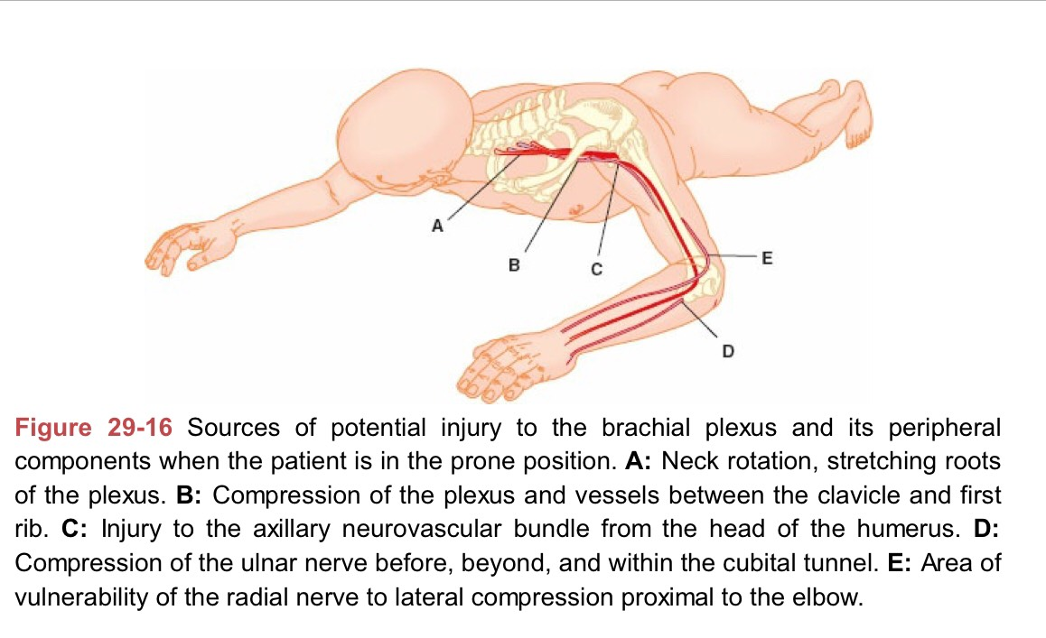
Prone position
Intraabdominal pressure IVC
Venous return CO
Improve V/Q matching of posterior segment of lung
Complications : POVL, bite injury, airway edema, eye injury , breast injury, branchial plexus injury, inadvertent loss of ETT, IV, monitoring
Clinical anesthesia : patient position and potential injuries ;8th ed;2017

Slide 25
Sitting position
Upper posterior cervical spine and posterior fossa surgery
Venous drainage of blood>> reduced blood in the operative field
Requires flexion at torso, hip flexion should be < 90 degrees
Minimize stretch on lower extremity
Miller’s anesthesia : patient positioning and associated risk,9th ed;2020

Slide 26
Sitting position
Shoulder are slightly elevated to avoidance neurovascular injury
Knees are slightly flexed for reduce stretching of sciatic nerve
Head be fixed with rigid pins or taped into a special headrest
Facial swelling is minimized, pulmonary mechanics are reasonably reserved
Miller’s anesthesia : patient positioning and associated risk,9th ed;2020

Slide 27
Sitting position
Miller’s anesthesia : patient positioning and associated risk,9th ed;2020

Slide 28
Sitting position
Miller’s anesthesia : patient positioning and associated risk,9th ed;2020

Slide 29
Complications in sitting position
Venous air embolism [VAE]
( tented open dural venous sinus + surgical field above level of heart )
Arrhythmias, desaturation, pulmonary hypertension, cardiac arrest
Associated with PFO
TEE [most sensitive monitor], TTD [most sensitive noninvasive monitor]
Treatment : stop surgery& flood the field with NSS
O2 100%, IV fluid, vasoactive agents
Miller’s anesthesia : patient positioning and associated risk,9th ed;2020

Slide 30
Complications in sitting position
Pneumocephalus
Spinal cord infarction [hyperflexion, hyperextension, external rotate of neck]
Cerebral ischemia [reduced CO >> reduced CBF]
Hypotension (pooling of blood in lower body >> MAP SBP CI )
Miller’s anesthesia : patient positioning and associated risk,9th ed;2020

Slide 31
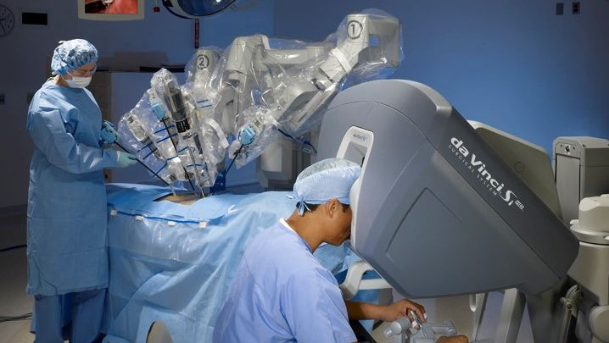
Robotic surgery
Robotic positioning involves urologic and gynecologic operation
Robot is docked, direct access to the patient is limited
Patient in steep Trendelenburg and lithotomy
Arms tucked in neutral position to the sides
Shoulder braces can causing branchial plexus injuries

Slide 32
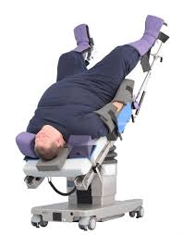
Robotic surgery
Physiologic changes are due to both laparoscopic insufflation and steep Trendelenburg
FRC peak and plateau airway pressure
Increased MV with carbon dioxide insufflation
Airway and facial edema, branchial plexus injuries (steep Trendelenburg)

Slide 33
Peripheral nerve injury
Serious perioperative complication
28% Ulnar neuropathy, 20% branchial plexus, 16% lumbosacral nerve root, 13% spinal cord
Mechanism of injury : stretch, compression, transection
Risk factor : HT, DM, peripheral vascular disease, older age, heavy alcohol drinking, tobacco use, prolonged surgical time, extremes of weight
Miller’s anesthesia : patient positioning and associated risk,9th ed;2020

Slide 34
Prevention of perioperative peripheral neuropathy

Slide 35
Prevention of perioperative peripheral neuropathy

Slide 36
Ulnar nerve injury
Ulnar nerve lie in postcondylar groove of the humerus [ulnar groove]
Supine patient with arm on an armboard [decrease pressure on the ulnar groove]
Place the forearm and hand in neutral position
Avoid flexion of the elbow to decrease the risk
Miller’s anesthesia : patient positioning and associated risk,9th ed;2020

Slide 37
Branchial plexus neuropathy
Limit arm abduction in a supine patient to <90 degrees
Avoid excessive lateral rotation of head [supine , prone]
Prone position may allow abduction their arms > 90 degrees
Avoid the placement of high axillary roll in the decubitus position
Avoid the use of shoulder braces when utilizing Trendelenburg
Miller’s anesthesia : patient positioning and associated risk,9th ed;2020

Slide 38
Median nerve neuropathy
Avoid extension of elbow beyond the range that is comfortable
prevent stretching of median nerve
Periodic assessment maybe performed to ensure maintenance of desired position
Miller’s anesthesia : patient positioning and associated risk,9th ed;2020

Slide 39
Radial nerve neuropathy
The spiral groove of humerus in the lower 1/3 of the arm
Wrist drop, inability to abduct the thumb or extend MCP jt.
Avoid prolonged pressure on radial nerve in spiral groove of humerus
Miller’s anesthesia : patient positioning and associated risk,9th ed;2020

Slide 40
Lower extremity positioning
Sciatic neuropathy
- Avoid excessive flexion of the hips , extension of knees
Femoral neuropathy
Loss of sensation over the anteromedial side of leg, decrease
flexion of hip, decrease extension of knee
- Avoid extension or flexion of hip
Peroneal neuropathy
- Foot drop, inability to extend the toes in a dorsal direction or evert the foot
- Avoid prolonged pressure at fibular head
Miller’s anesthesia : patient positioning and associated risk,9th ed;2020

Slide 41
Evaluation and treatment of perioperative neuropathy
Prevention of perioperative peripheral neuropathy

Slide 42
Evaluation and treatment of perioperative neuropathy
Prevention of perioperative peripheral neuropathy

Slide 43
Evaluation and treatment of perioperative neuropathy
Prevention of perioperative peripheral neuropathy

Slide 44
Evaluation and treatment of perioperative neuropathy
Electrophysiologic evaluation by neurologist within first week
Nerve conduction test may be useful to evaluate potential peripheral nerve injury
Electromyographic study may distinguish between radiculopathies, plexopathies, neuropathies
Sensory neuropathy >> reassure
Neurapraxia, motor neuropathy >> 4-6 wk.
Axonotmesis, neurotmesis >> 3-12 months

Slide 45
Pressure injury
Injury to the skin or underlying tissue due to shearing force
23% pressure ulcer occur in OR
Early sign : nonblanching skin erythema
The skin is more resistant to pressure injury than muscle
increase O2 requirement of muscle
Factor : bony prominent area, compromise blood flow, shear force skin breakdown, infection, inflammation
Miller’s anesthesia : patient positioning and associated risk,9th ed;2020

Slide 46
Perioperative visual loss
POVL is a rare but serious complication
Retinal ischemia : BRAO, CRAO
Ischemic optic neuropathy : AION, PION
Miller’s anesthesia : patient positioning and associated risk,9th ed;2020

Slide 47
Central retinal artery occlusion
Painless visual loss, abnormal pupil activity, opacification of the ischemic retina
Usually compression eye, emboli form cardiac surgery
Mechanism
External compression of eye
Decrease arterial supply [ embolism/ decreased systemic blood flow]
Impair venous drainage
Thrombosis from coagulation disorder
Miller’s anesthesia : patient positioning and associated risk,9th ed;2020

Slide 48
Branch retinal artery occlusion
Lead to permanent ischemic retinal damage with partial visual field loss
Associated with emboli, less vasospasm
Miller’s anesthesia : patient positioning and associated risk,9th ed;2020

Slide 49
Treatment
Permanent loss of vision in most cases
Current available treatment is unsatisfactory
Intra venous acetazolamide
95% O2 can enhance dilation and increase O2 delivery from retinal and choroidal vessel
Fibrinolysis through the ophthalmic artery within 6-8 hr. after spontaneous CRAO
Miller’s anesthesia : patient positioning and associated risk,9th ed;2020

Slide 50
Ischemic optic neuropathy
Mechanism : disruption of blood brain barrier
Onset within 24-48 hr. after surgery
AION [cardiac surgery], PION [spine surgery]
Painless visual loss, afferent pupil defect or nonreactive pupils
no light perception, visual field deficit, color vision is decreased
Miller’s anesthesia : patient positioning and associated risk,9th ed;2020

Slide 51
Treatment
No effective treatment exists for ION
Acetazolamide decreased IOP
Diuretic reduce edema
Corticosteroid may reduce axonal swelling in acute phase
Maintaining the patient in head-up position if increased IOP
Miller’s anesthesia : patient positioning and associated risk,9th ed;2020

Slide 52
Perioperative visual loss

Slide 53
Task force summary of advisory statement

Slide 54
Task force summary of advisory statement

Slide 55
Task force summary of advisory statement

Slide 56
Task force summary of advisory statement

Slide 63
Thank you

